Slide 1

INTERNSHIP FINAL PROJECT
AI Skill-to-Opportunity Translator
An explainable, agent-driven career mapping system utilizing deterministic logic and Generative AI to bridge the skill gap aligned with SDG 8.
Full Name : Sakshi Giglani
Registered Mail ID : sakshigiglani11@gmail.com
College Name : GLS Universe, Ahmedabad.
Mob No. : 7069052453
IBM SkillsBuild platform mail ID : sakshigiglani11@gmail.com

Slide 2



Executive Summary
The AI Skill-to-Opportunity Translator is an applied AI system designed to democratize career guidance. Unlike traditional "black-box" recommenders, this system prioritizes transparency and explainability.
By accepting unstructured text input, the system leverages a modular, agent-based pipeline to:
Normalize: Convert diverse skill descriptions into industry-standard taxonomy.
Map: Correlate user competencies with real-world job role requirements.
Explain: Provide generative AI-driven context for every recommendation without hallucinating the core logic.

Slide 3





Problem Statement & Motivation
The "Black Box" Dilemma
The Skill-Role Disconnect
Static Keyword Limitations
Existing career platforms often rely on opaque predictions. Users receive recommendations without understanding the rationale, leading to low trust and poor adoption.
Students often possess relevant technical skills (e.g., specific libraries or frameworks) but fail to understand how these translate to industry-standard job titles.
Traditional resume parsers rely on rigid keyword matching, failing to recognize skill aliases (e.g., "ReactJS" vs. "React") or nuances in proficiency.

Slide 4

Strategic Alignment
Sustainable Development Goal 8
Decent Work and Economic Growth
This project is explicitly aligned with Target 8.6: Substantially reduce the proportion of youth not in employment, education, or training.
Employability Awareness: Bridging the information asymmetry between academic curricula and industry needs.
Transparent Access: Providing high-quality career mapping tools accessible to anyone with an internet connection.
Informed Decision Making: Empowering users to identify and close specific skill gaps.

Slide 5


High-Level System Architecture
Deterministic Core
Generative Explanation Layer
The logic engine responsible for accurate data processing.
The synthesis engine responsible for user communication.
Normalization Layer: Maps aliases to canonical forms.
Gemini API: Generates natural language summaries.
Role Mapping Agent: Uses predefined, validated ontologies.
Gap Articulation: Explains why a specific skill is needed.
Scoring Algorithm: Calculates fit based on weighted skill matches.
Contextualization: Translates data points into a narrative.
* This hybrid approach eliminates AI hallucinations in critical decision-making steps.

Slide 6







Development Workflow
Analysis & Setup
Agent Development
Integration
Frontend & UI
Requirement gathering, SDG alignment, and establishing the Python/FastAPI backend environment.
Building the Skill Extraction, Normalization, and Role Translation agents using modular logic.
Orchestrating agents via LangGraph and integrating the Gemini API for the explanation layer.
Developing the interactive Streamlit interface and implementing PDF/JSON report generation.

Slide 7
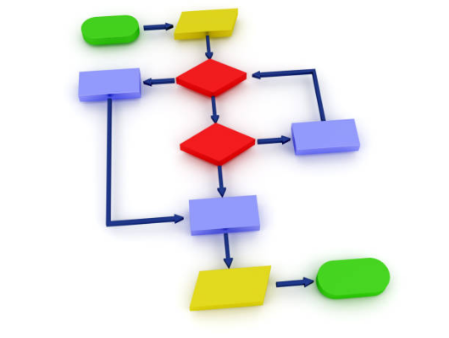
Key Technical Modules
Skill Extraction & Normalization
Handling unstructured free-text input is a primary challenge. The system employs a multi-step process:
Tokenization: Breaking down user input into constituent parts.
Alias Mapping: A dictionary-based approach maps variations (e.g., "cpp", "c++", "C plus plus") to a single canonical ID.
Noise Reduction: Filtering out non-technical stop words to focus purely on employability signals.

Slide 8





Technology Stack
Python
FastAPI
LangGraph
Streamlit
Core Runtime Environment
High-Performance Backend API
Agent Orchestration Framework
Rapid Frontend Development

Slide 9

Responsible AI & Ethics
Deterministic Rankings: Career suggestions are based on hard logic, not probabilistic guesses, preventing bias in role selection.
"The system is designed to inform, not to dictate. We provide clarity on the 'why' behind every mapping."
Explanation-Only Generative AI: LLMs are restricted to explaining results, ensuring no "hallucinated" career paths are invented.
Transparency: Skill gaps are presented neutrally as areas for growth, not as personal shortcomings.
— Design Principle

Slide 10

Project Outcomes
100%
0
3
Logic Explainability
Generative Hallucinations
Fit Categories (Strong/Partial/Exploratory)
Future Scalability
The modular agent design allows for immediate integration of future features such as PDF Resume Parsing, Real-time Job Market Data APIs, and University Course Mapping.

Slide 11


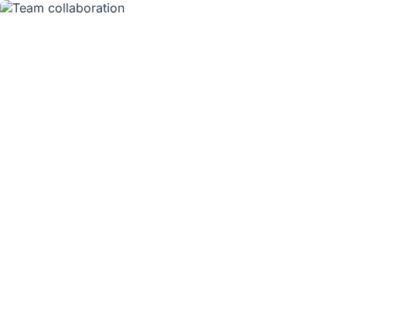
Project Context
Collaborative Development
This project represents a synthesis of modern software engineering practices, including:
Version Control: Structured GitHub repository with professional documentation.
Agile Methodology: Iterative testing and refinement of the skill normalization layer.
Documentation: Comprehensive concept notes and Lean Canvas models.

Slide 12
Thank You
Questions & Discussion
Github: https://github.com/027Sakshi/AI-SKILL-TRANSLATOR
Drive: https://drive.google.com/drive/u/5/folders/12lB6MOl5aQr1jA2M8PtvPr-3c4phZoDS

